Slide 1
Session 6
A Guide to Advanced Java
Annotations
A Guide to Advanced Java
<number>/28

Slide 2
Summary
Annotations can be read from source files or classes files
Annotation type name should begin with @ symbol
Custom Annotation
Reflection API Reflection is the ability of classes, objects and interfaces to find information about itself.
Examining classes
Manipulating objects
Working with Arrays: New array objects can be instantiated and array elements can be accessed and modified using methods associated with
Create by faculty ChungLD
A Guide to Advanced Java
<number>/28

Slide 3
Objectives
Introduction to Annotations
Standard Annotation type
Custom Annotation
A Guide to Advanced Java
<number>/28

Slide 4
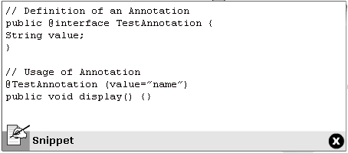
Introduction to Annotations
Annotations help associate metadata to the program elements. Annotations can be read from source files or classes files. Comments in code are replaced by annotations in many places.
Annotation consists of are:
  Annotation
  Annotation type.
A Guide to Advanced Java
<number>/28

Slide 5
Rules for Defining Annotation Type
Annotation name should begin with @ symbol followed by the keyword interface and the annotation name.
Parameters should not be associated with method declarations.
Throws clause should not be used with method declarations
Return types of method declaration should be either primitive, String, Enum, Class or array of the above types.
A Guide to Advanced Java
<number>/28

Slide 6
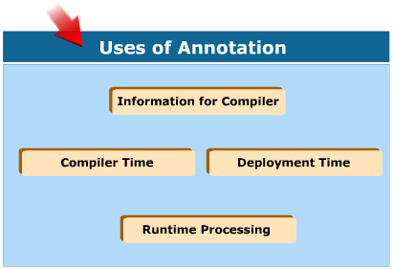
Uses of Annotations
A Guide to Advanced Java
<number>/28

Slide 7
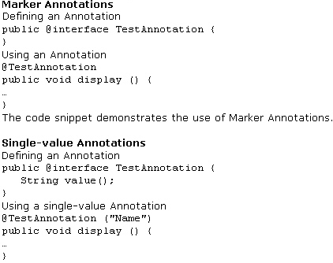
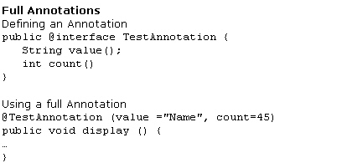
Categories of Annotations
The three categories of Annotations are:
  Marker Annotations
  Single-value Annotation
  Full Annotations
A Guide to Advanced Java
<number>/28

Slide 8
Applying Annotations
Annotation can be used to annotate the following items
  Classes
  Methods
  Packages
  Interfaces
  Local variables
  Constructors
A Guide to Advanced Java
<number>/28

Slide 9

“@Deprecated” Annotation
The @Deprecated annotation is used to indicate that the marked element is deprecated and should not be used. The compiler will generate a warning whenever a programmer uses a deprecated item. This annotation does not support any arguments.
A Guide to Advanced Java
<number>/28

Slide 10
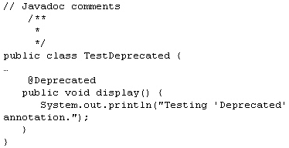
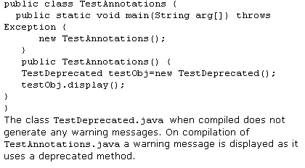
Example
A Guide to Advanced Java
<number>/28

Slide 11

“@Override” Annotation
The @Override annotation in a program element informs the compiler that the element will override another element present in the superclass. A compiler error is generated if the compiler detects that the method is not correctly overriding the method present in the superclass.
A Guide to Advanced Java
<number>/28

Slide 12
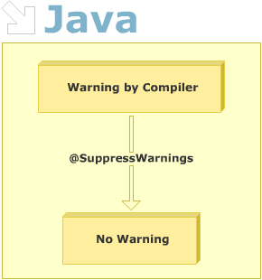
“@SuppressWarnings” Annotation
The @SuppressWarnings annotation is used to inform the compiler to suppress certain warnings in the annotated code element that would otherwise have been generated.
Deprecation and unchecked
A Guide to Advanced Java
<number>/28

Slide 13
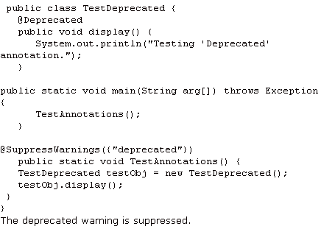
Example
A Guide to Advanced Java
<number>/28

Slide 14

“@Documented” Annotation
The @Documented annotation specifies that it should be included in the documentation, documented by the javadoc tool. Annotations are not included by javadoc comments.The use of the @Documented annotation in the code will enable tools like javadoc to process it and include the annotation type information in the generated document.
A Guide to Advanced Java
<number>/28

Slide 15
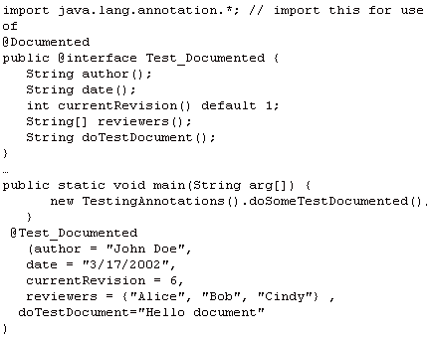

Example
A Guide to Advanced Java
<number>/28

Slide 16
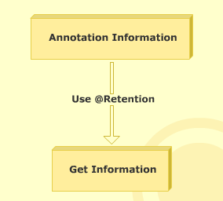
“@Retention” Annotation
The annotation type annotated with @Retention determines where and how long the annotation is retained. The three values that the @Retention
  RetentionPolicy.SOURCE
  RetentionPolicy.CLASS
  RetentionPolicy.RUNTIME
A Guide to Advanced Java
<number>/28

Slide 17
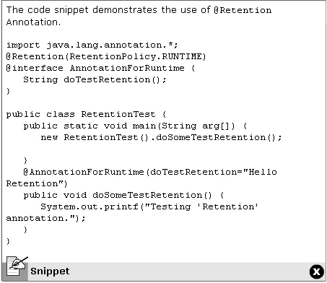
Example
A Guide to Advanced Java
<number>/28

Slide 18
Annotation for Classes
Annotations can be added to Java code constructors. To create an annotation type for classes, the @ symbol followed by the keyword, interface and the annotation name is used. The annotation type should be saved with a .java extension. Annotations will be compiled to .class files.
Parameters can be added to Annotation declaration
  Parameters will not have a null value
  Parameters can have a default value.
  Pararmeters are written as simple methods
  Parameters can be arrays of comma-separated values of primitive datatype.
A Guide to Advanced Java
<number>/28

Slide 19
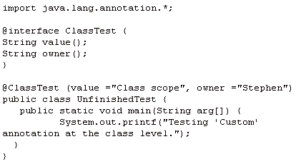
Example
A Guide to Advanced Java
<number>/28

Slide 20
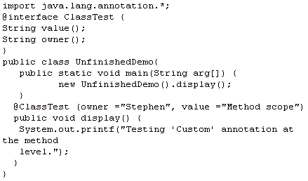
Annotation for Methods
A Guide to Advanced Java
<number>/28

Slide 21
Summary
Annotations can be read from source files or classes files
Annotation type name should begin with @ symbol
Custom Annotation
Create by faculty ChungLD
A Guide to Advanced Java
<number>/28

Slide 22

Summary and Workshop
A Guide to Advanced Java
<number>/28

